Slide 1
Don’t reinvent the wheel: making use of shiny extension packages
Münster R User Group

Slide 2




Hi!
I’m Suthira Owlarn :)
Biologist/postdoc at the Max Planck Institute
R newbie (~1.5 years)
Shiny enthusiast!
@s_owla
sowla
2019-MS-RUG-shiny-extensions

Slide 3
Shiny

Slide 4
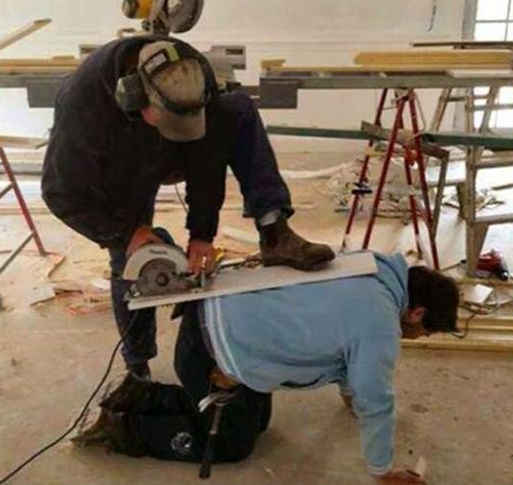


Slide 5
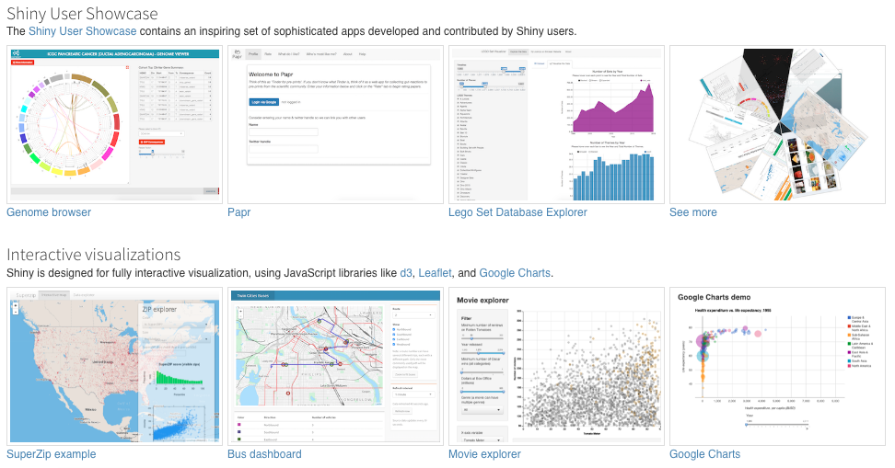
Shiny

Slide 6
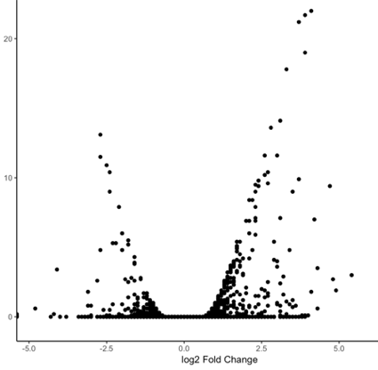
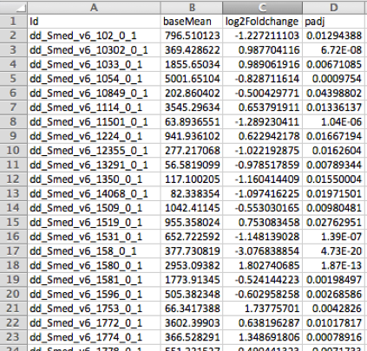
Why did I start using shiny?
-Log10 adjusted p-value
Log2 Fold Change

Slide 7

Why did I start using shiny?

Slide 8
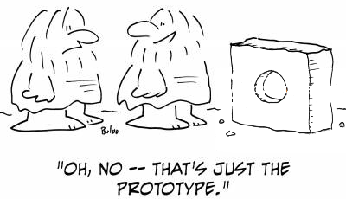
Demo

Slide 9
Let’s chat! :)
Do you actually need shiny?
Straight out of the shiny box
Judging a book by its cover
More ways to add to add to the UI/UX
Tools to help your shiny workflow

Slide 10
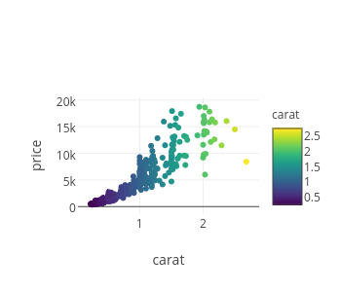
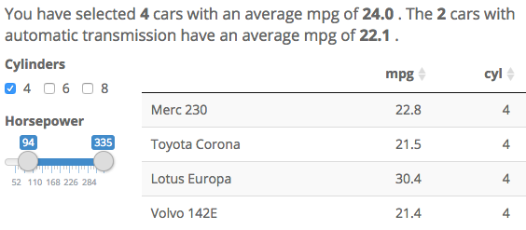
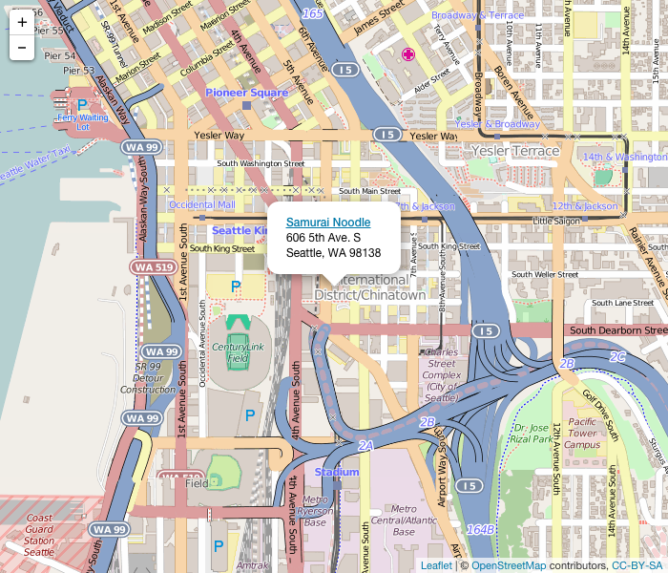
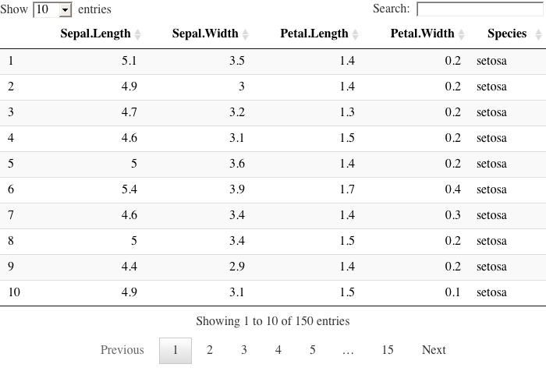
Do you actually need shiny?
plotly
summarywidget
Crosstalk
HTML report demoed
Linked data sets
Filter/selection
Some interactivity without needing shiny
Some compatible widgets ->
Make your own using htmlwidgets or reactR
leaflet
DT

Slide 11
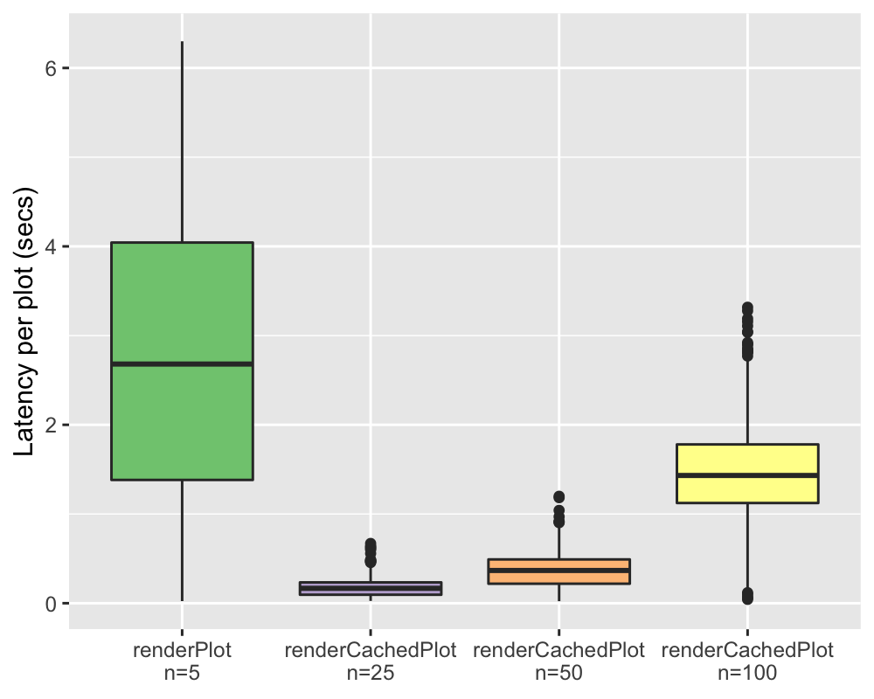
Right out of the shiny box
Easy to make boostrap-based web apps
Multiple inputs/outputs
Fine-tuned reactivity
Dynamic UI
Modules
Bookmarking
Shiny 1.2.0 (Nov 2018):
Plot caching
Notes:
debounce/throttle reactives, ignoreInit, once, flush

Slide 12
Judging a book by its cover
16 shinythemes
shinydashboard
Notes:
RStudio’s official packages

Slide 13
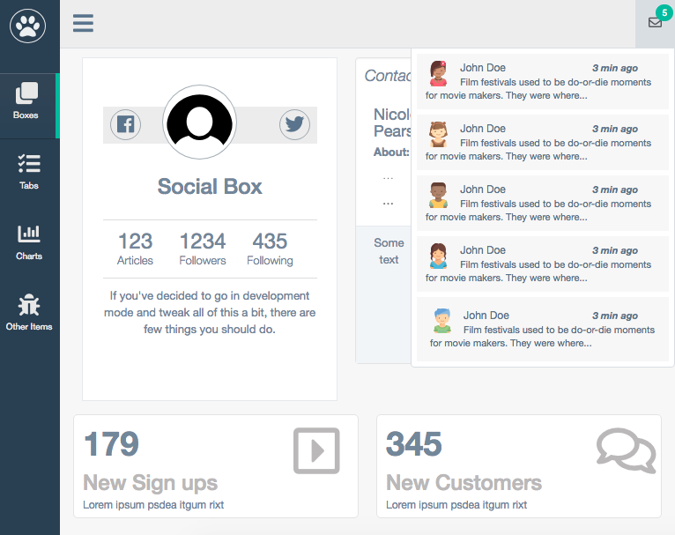
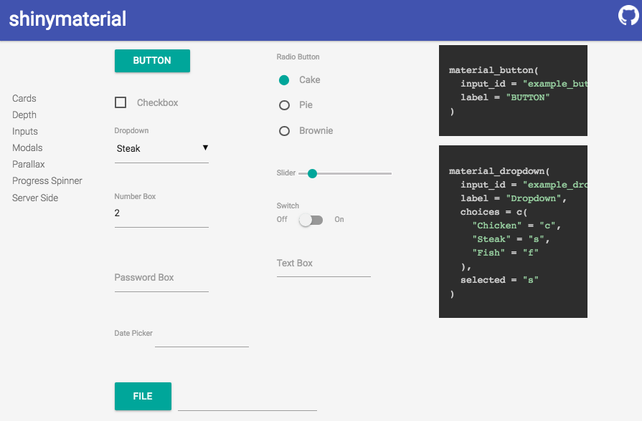
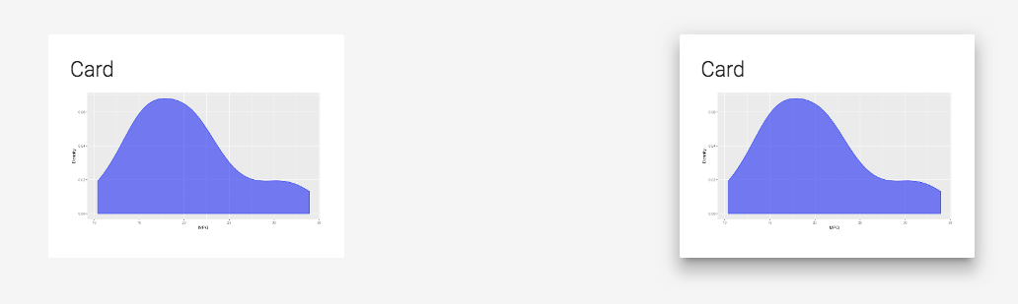
Judging a book by its cover
gentelellaShiny
shinymaterial
Notes:
Some more polished/professional; based on:
Gentelella Admin (free Bootstrap admin template), Materialize (a CSS Framework based on Material Design)

Slide 14
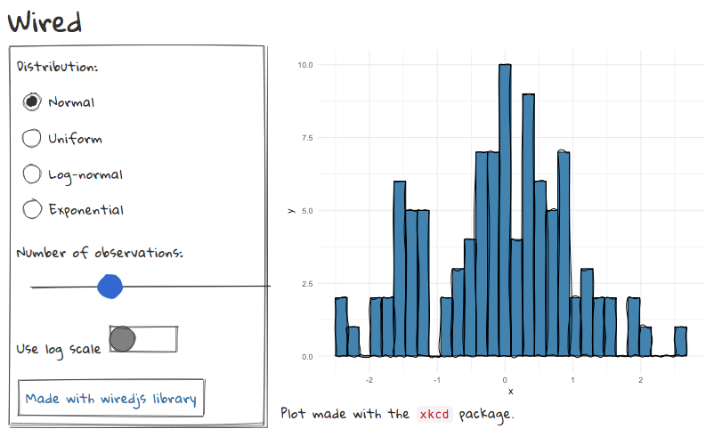
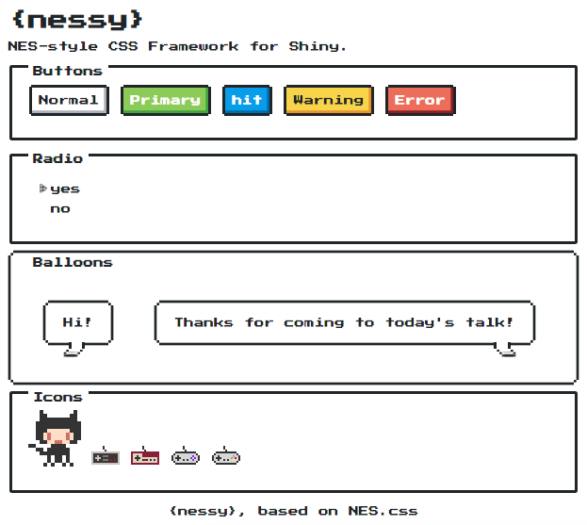
Judging a book by its cover
wired (+ xkcd)
nessy
Notes:
Others more for fun; based on:
Wireframe/Nintendo (Nintendo Entertainment System) style js libraries

Slide 15
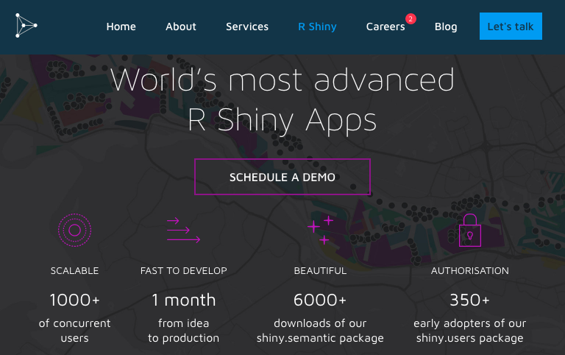
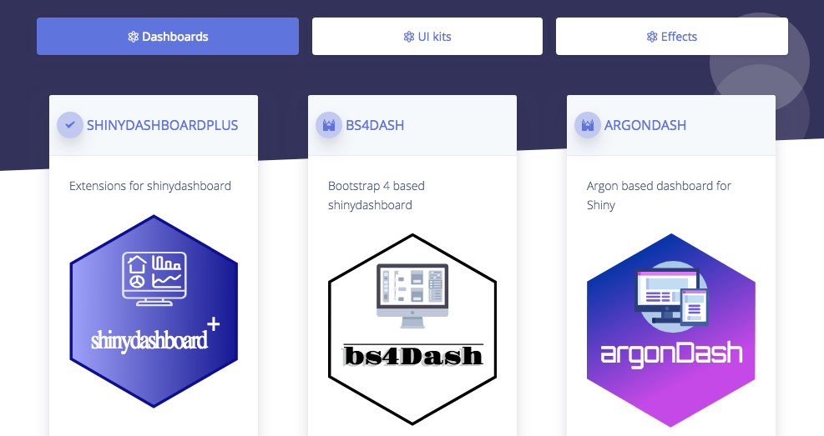
Judging a book by its cover
appsilon
rinterface
shiny.semantic + semantic.dashboard
shinydashboardPlus, bs4Dash,
argonDash + argonR, shinybulma
Also: shiny supports HTML templates
Notes:
Other UI themes: argon, bulma (often existing libraries/frameworks ported into R)
Additional dashboard features include eg. user cards, sortable cards, galleries, timeline

Slide 16
More ways to add to the UI/UX
shinyAce
colourpicker
shinyTree
more UI elements:
shinyWidgets, shinyBS, bsplus, TileMaker
Notes:
more elements: including collapse/accordian panels, modals, tooltips, popovers, dropdown buttons, sliders with text, knob input
https://github.com/thomasp85/shinyFiles

Slide 17
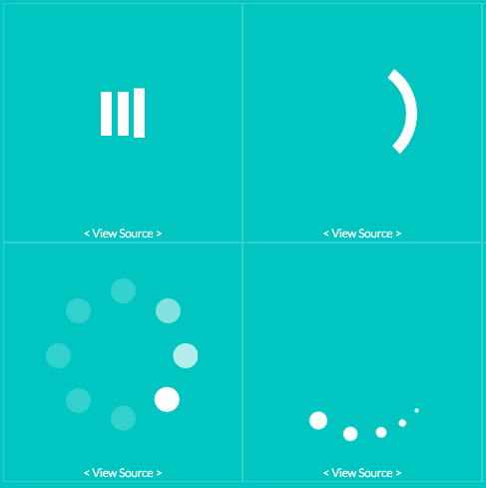

More ways to add to the UI/UX
shinyFeedback
shinycssloaders
rintrojs
step-by-step introductions, clickable hints (from intro.js)
shinyjs
Easy ways to eg.
Show/hide
Enable/disable
shinycustomloader
shinyEffects
CSS effects

Slide 18
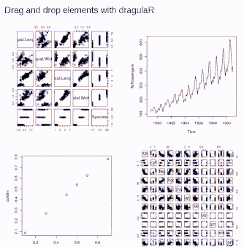
More ways to add to the UI/UX
Interact with/edit elements
shinysense – "help shiny sense the world around it"
shinyswipr - cards that can be swiped left/right
shinydrawr, shinyearr, shinyviewr, shinymovr
shiny.router – helps create paged URLs
shiny.i18n – helps with internationalisation
shiny.collections – "Google Docs-like live collaboration in Shiny"
fullPage – embed multiple shiny apps in one
shinyjqui, dragulaR, shinydnd
Notes:
shinyjqui: drag and drop, resize, sort UI elements

Slide 19
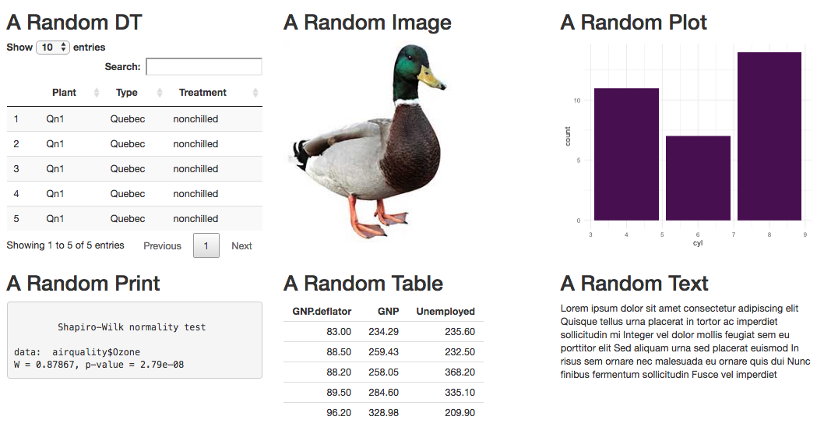
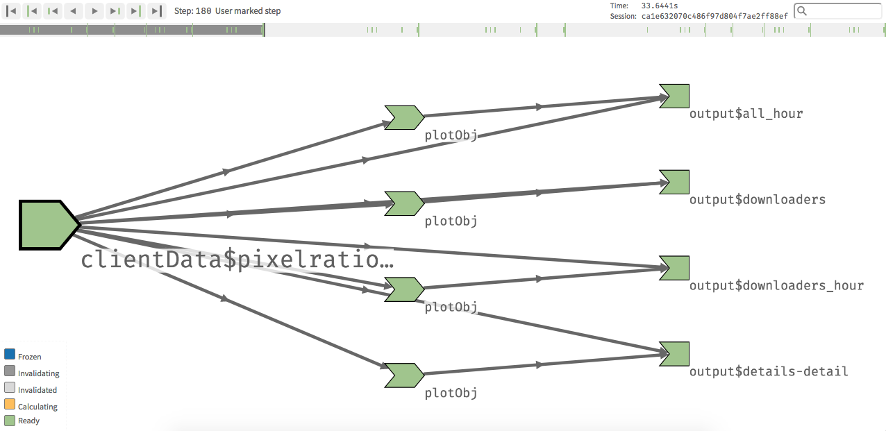
Tools to help your shiny workflow
shinipsum (for prototyping)
shinytest (test overall function)
reactlog (talk, demo)
alternatively, RSelenium
unit test underlying functions, eg. testthat
frankenstein to “resurrect” your app
shinysnippets to save you some typing
Notes:
(Reactlog not 100% working yet..? Check!)

Slide 20
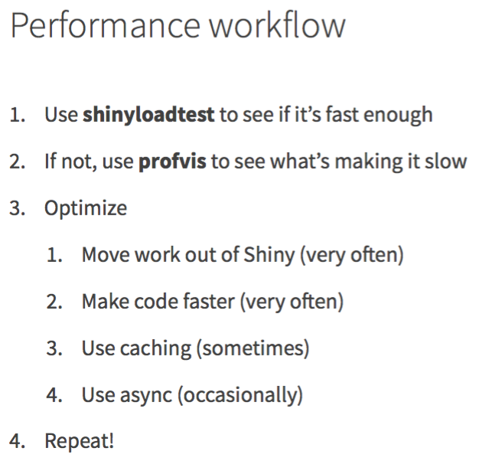
Tools to help your shiny workflow
shinyloadtest
profvis (+ eg. microbenchmark)
Joe Cheng, rstudio::conf 2019 keynote

Slide 21
Tools to help your shiny workflow
Asynchronous programming
future, promises
ipc
furrr
Joe Cheng, rstudio::conf 2019 keynote

Slide 22
Tools to help your shiny workflow
Shiny + Electron
Alternative to shinyapps.io/Shiny Server/RStudio Connect
Katie Sasso’s UseR 2018 talk (Shiny meets Electron: Turn your Shiny app into a standalone desktop app in no time)
Columbus Collaboratory’s electron-quick-start github repo
More materials:
Shiny in production: Joe Cheng’s keynote and Kelly O'Briant’s (WIP) book
Building Big Shiny Apps - A Workflow blog post
shinytemplate “an RStudio project template for building prod-ready shiny apps”

Slide 23
A few sources for shiny updates/advice
@_ColinFay/@Thinkr_FR
eg. various advice on working with shiny, especially shiny in production
@_pvictorr/@dreamRs_fr
eg. esquisse: a package and RStudio add-in for ggplot2 GUI
@nic_crane
eg. a javascript snippet to get confirmation when clicking back/forward buttons
inspired by her, I added a bit of code for the refresh button as well
Rstudio also has shiny tutorials, videos and a cheatsheet
Joe Cheng is writing a “Mastering Shiny” book

Slide 24
Don’t reinvent the wheel: making use of shiny extension packages
Münster R User Group
@s_owla
sowla
2019-MS-RUG-shiny-extensions

